Slide 1






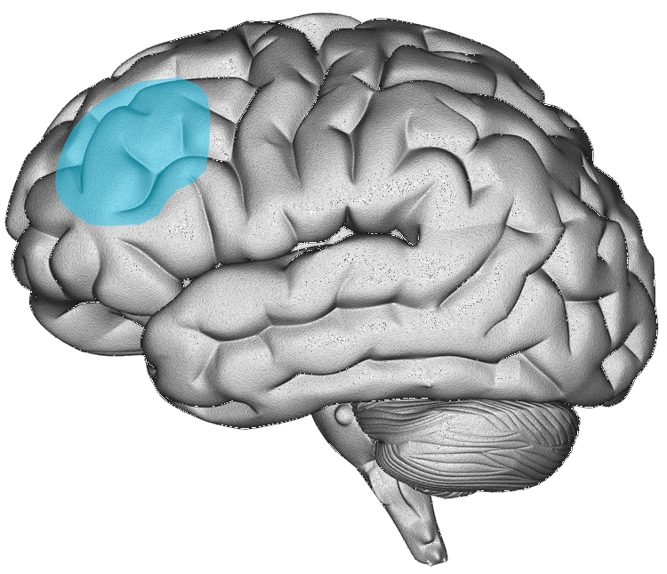
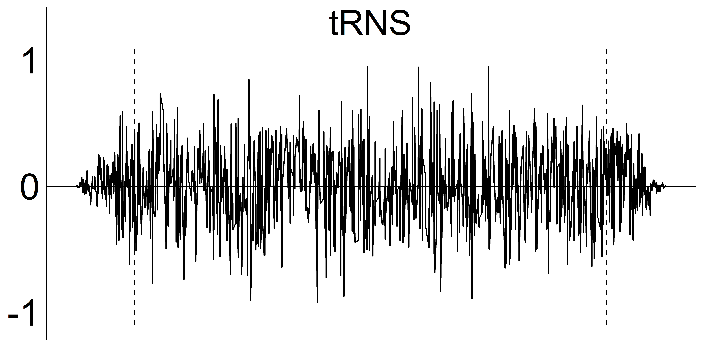
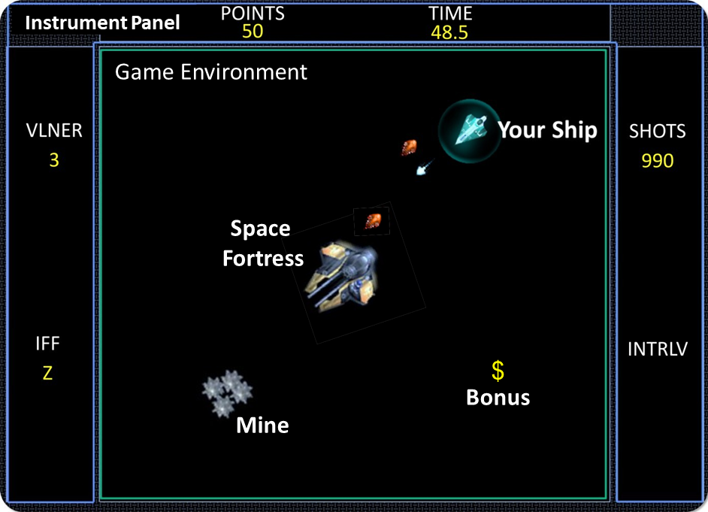
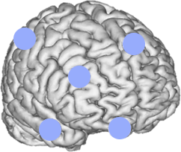

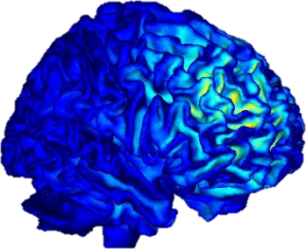
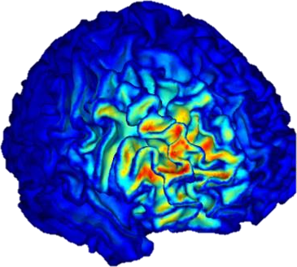
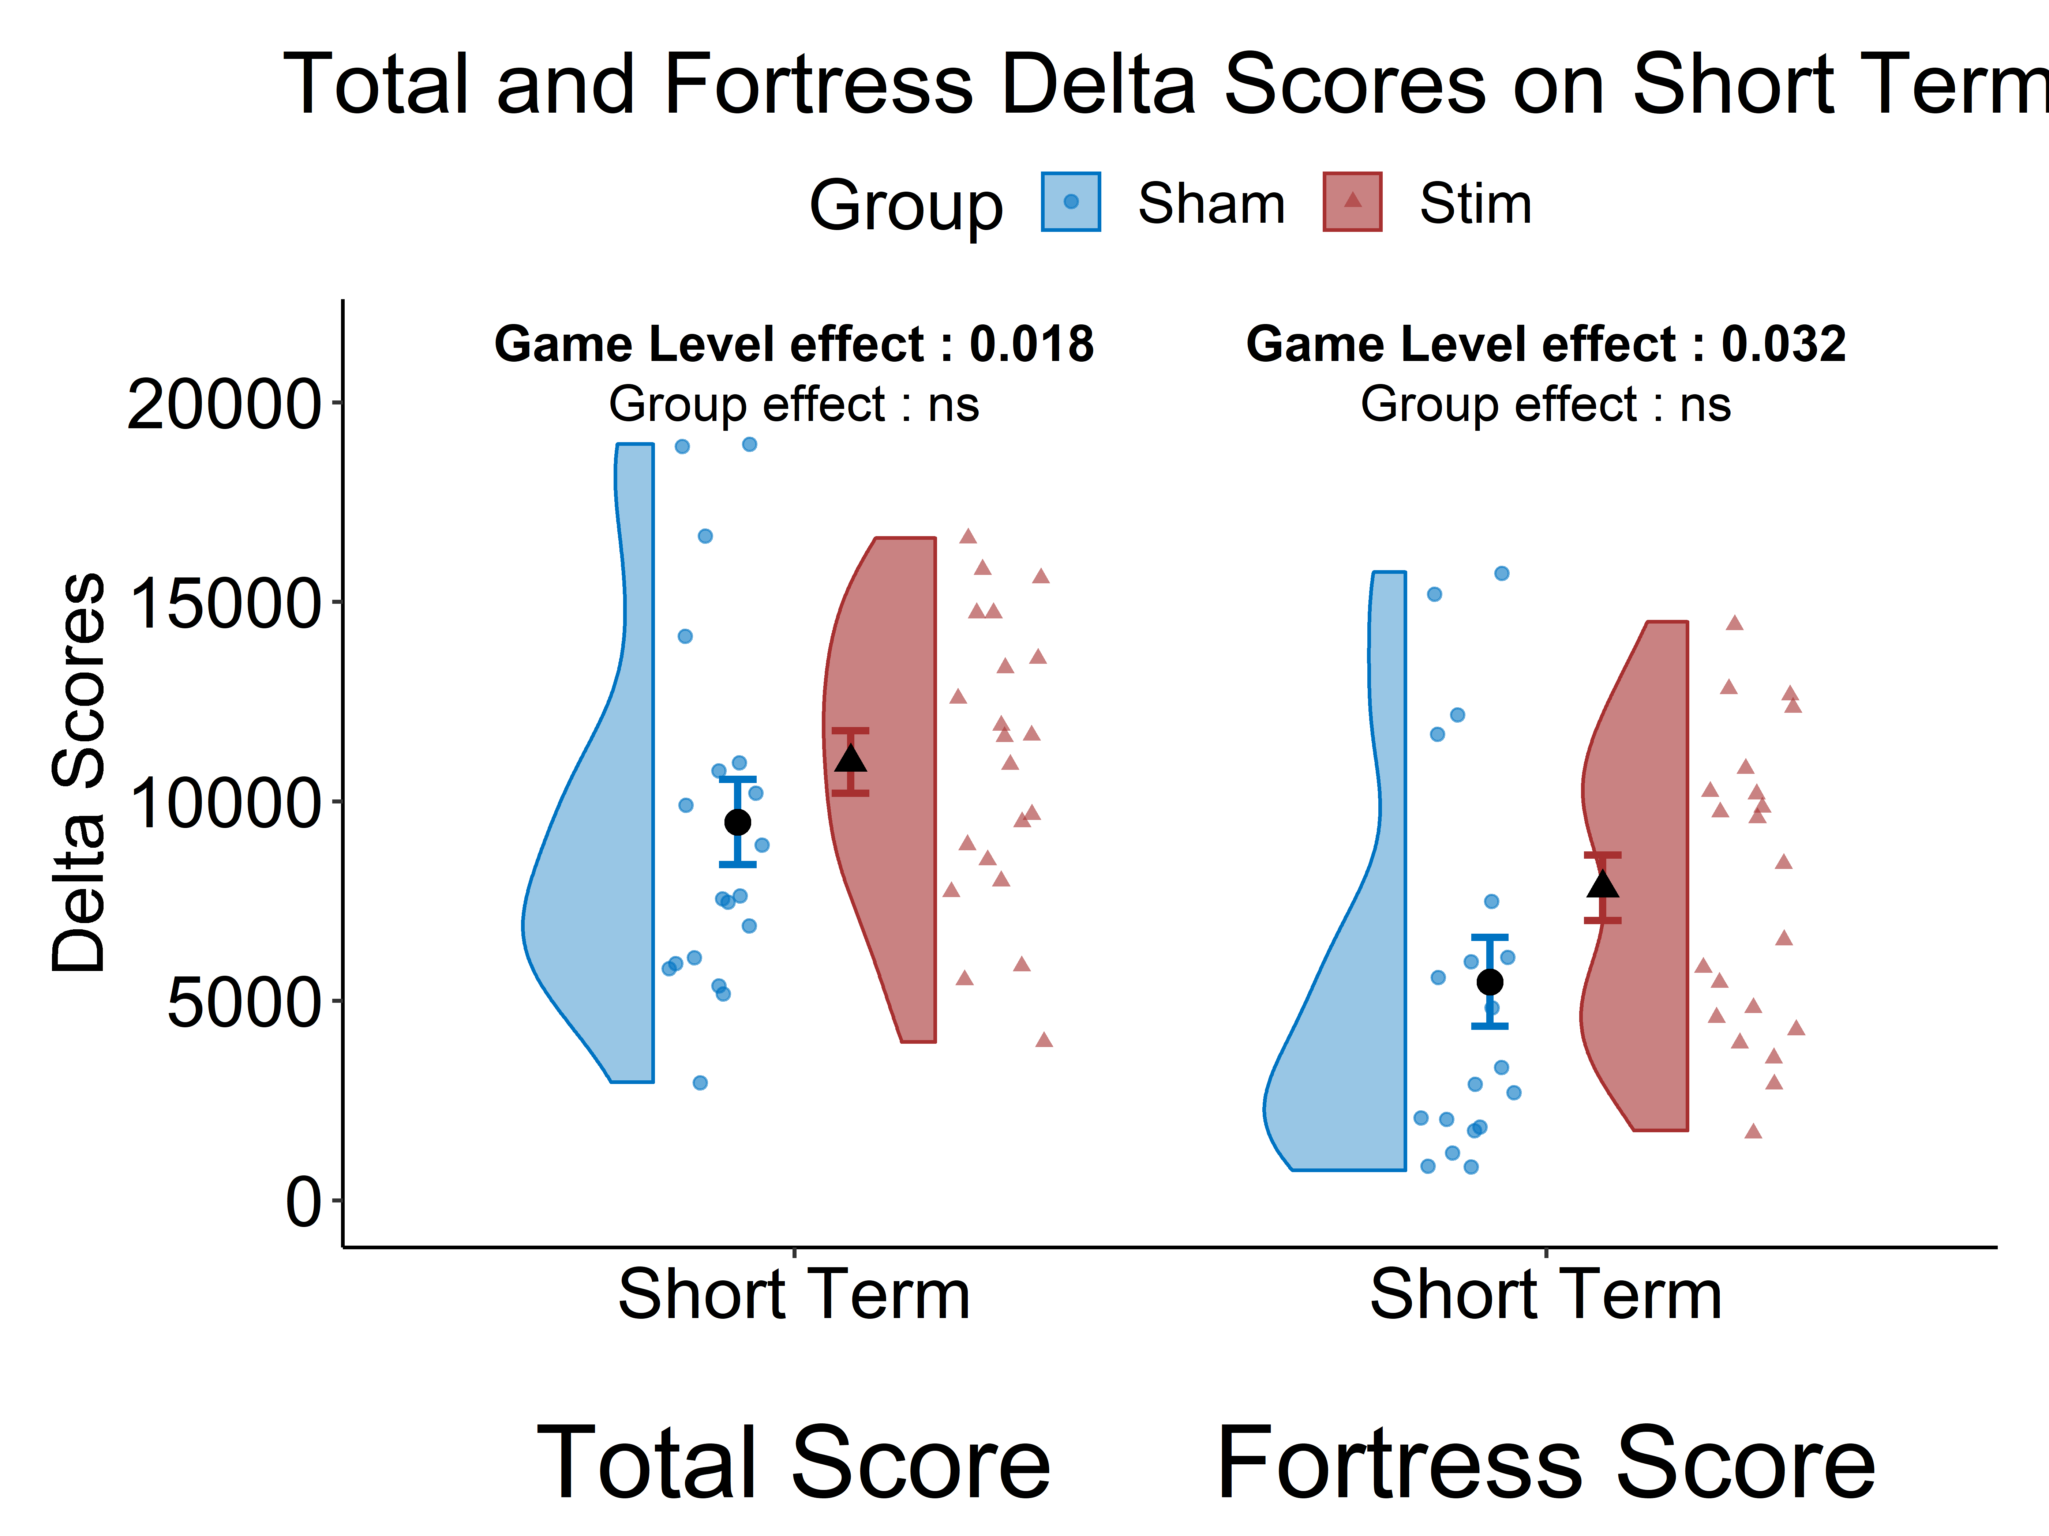
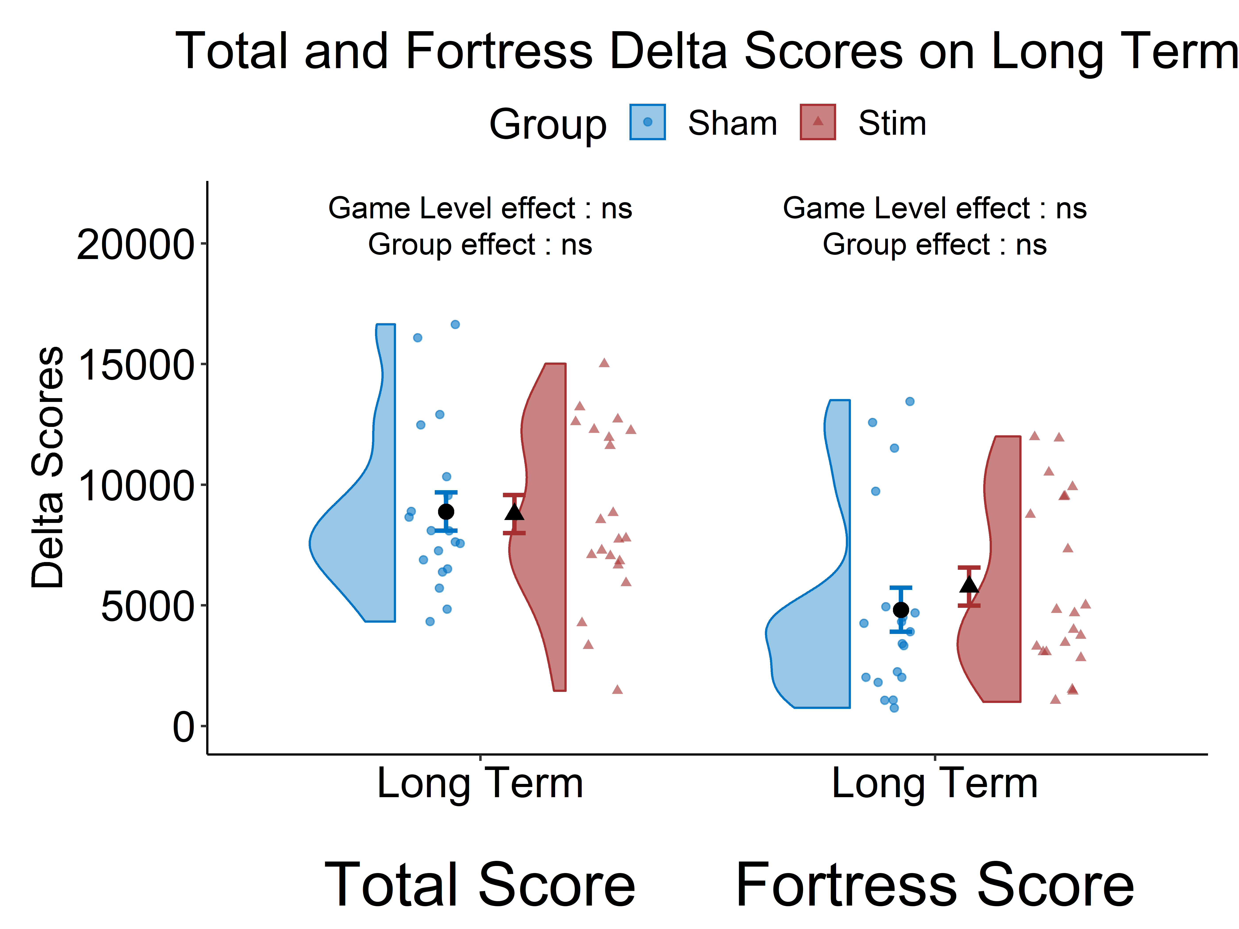
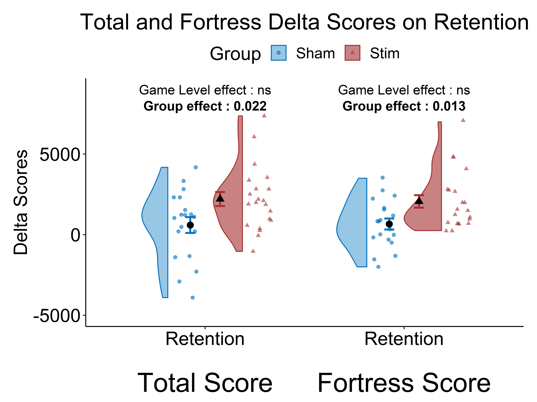
Transcranial random noise stimulation enhances retention performance after training of a complex cognitive task.
Caroline Hamery¹, Quentin Chenot¹, Evelyne Lepron¹, Pierre Besson², Xavier De Boissezon^{3,4}, Stéphane Perrey² & Sébastien Scannella¹
¹ ISAE-SUPAERO, Université de Toulouse, Toulouse, France
² EuroMov Digital Health in Motion, Univ Montpellier, IMT Mines Ales, Montpellier, France
³ Toulouse Neuroimaging Center (ToNIC), Université de Toulouse, INSERM, Toulouse, France
⁴ Department of Physical Medicine and Rehabilitation, University Hospital of Toulouse, Toulouse, France
Introduction
Objectives
Transcranial Random Noise Stimulation (tRNS) :
Learning reinforcement of complex task management
Inducing noise in the neural system
Effects and mechanisms still in debate¹
The Space Fortress videogame :
Pseudo ecological task
Designed to study complex task learning²
One week training
To assess the effect of tRNS over behavioral performance in complex task training
Target : right Dorsolateral Prefrontal Cortex (rDLPFC)
Based on Snowball et al. (2013)⁴
rDLPFC
right Dorsolateral Prefrontal Cortex
complex task management³
Hypothesis
Better long-term and retention performances for the stimulated group compared to sham.
Methods
p
The Space Fortress Game
40 Healthy Participants
Total Score
randomly assigned
Sum of 4 Sub-Scores
Fortress Score
STIM
SHAM
Random noise Stimulation pattern
Flight Score
Each participant performed 11 game sessions (GS) over 7 consecutive days and 2 GS 10 days later.
C4
FZ
Mine Score
1 Game Session :
Montage
F8
F4
FP2
Bonus Score
2 * 10” Space Fortress
SHAM
tRNS
20” Stimulation (STIM or SHAM)
Baseline
Stimulation / Training
Evaluations
Influence
Map
Training 1
Training 2
Training 3
Short-Term
Long-Term
Day 1
Day 2
Day 3
Day 4
Day 5
Day 15
GS1
GS2
GS3
GS4
GS5
GS6
GS7
GS8
GS9
GS10
GS11
0
0.02
0.04
0.06
0.08
0.10
||En|| (mV)
Results
Retention
SHAM & tRNS High Definition Montages
No Group effect on Short Term nor Long Term ∆ Scores
Group effect on Retention ∆ Score
>
STIM
SHAM
Conclusion
Perspectives
Stimulation of the rDLPFC
Further study on light aircraft pilots
tRNS during ecological behavioral task : flight and multitasking
Further evidence of a possible consolidation effect of focal tRNS over complex task management
MAY NOT INDUCE
MAY LEAD TO
Faster Learning
Global progress of performance
Better consolidation effects of what has been learned
Stimulation of a specific network may not have a macroscopic effect ⁵
REFERENCES
Fertonani, A. & Miniussi, C. Transcranial electrical stimulation: What we know and do not know about mechanisms. Neuroscientist 23, 109–123 (2017).
Mané, A. & Donchin, E. The space fortress game. Acta Physiol. (Oxf) 71, 17–22 (1989).
Kaller, C. P., Rahm, B., Spreer, J., Weiller, C. & Unterrainer, J. M. Dissociable contributions of left and right dorsolateral prefrontal cortex in planning. Cereb. Cortex 21, 307–317 (2011).
Snowball, A. et al. Long-term enhancement of brain function and cognition using cognitive training and brain stimulation. Curr. Biol. 23, 987–992 (2013).
Hebb, D.O. (2002). The Organization of Behavior: A Neuropsychological Theory (1st ed.). Psychology Press.

